Slide 1
Continuous Testing
Using Selenium & NUnit in C#

Slide 2
Outlines
Introduction to Testing
Why NUnit?
Creating Test Cases in NUnit
NUnit Integration with TeamCity
Implementation of Selenium in the Sample Project Hands-on:
Installing NUnit
Creating Test Cases in NUnit
Integrating NUnit with TeamCity

Slide 3
What is automated testing?
Test automation is a special way of executing tests where it compares the actual outcomes with
predicted or expected outcomes using a special software
Top Automated testing tools
Selenium
TestingWhiz
TestComplete
Ranorex
Telerik TestStudio
WatiN

Slide 5
Why automate tests?
Increase effectiveness and productivity
Increase efficiency
Removes human error in the process
Saves time and money
Increase test coverage

Slide 6
What is Selenium?
Selenium is a free automation testing framework for web applications
Compatible with different browsers
Selenium can interact with elements in a web page
Click
Type
Extract data
Basically almost anything you can do with a webpage
Supports multiple languages like C#, Java, PHP, Python, etc

Slide 7
What is NUnit?
Nunit is a unit-testing framework for all .NET languages
Nunit has a [TestCase] attribute that allows multiple parameters or testcases for a single unit test
Faster than MsTest
More mature than MsTest
NUnit can inherit abstract classes to be TestFixtures, MSTest can’t
NUnit is meant for Unit Testing. MSTests is more broad (i.e. Performance testing)

Slide 8
Selenium
WEBDRIVER COMMANDS, LOCATORS, ETC

Slide 9
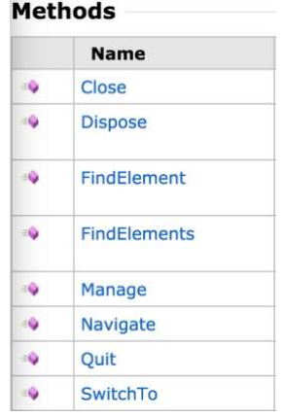
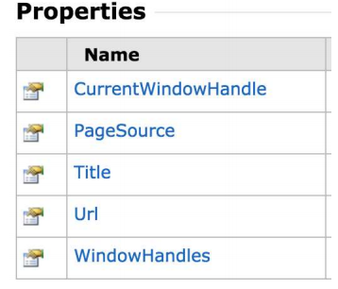
WebDriver
IWebDriver
It’s an interface through which the user controls the browser
ex. ChromeDriver implements IWebDriver

Slide 10
Browser Navigation
Four Navigation Commands
GoToUrl
driver.Navigate().GoToUrl(”google.com");
Back
driver.Navigate().Back();
Forward
driver.Navigate().Forward();
Refresh
driver.Navigate().Refresh();

Slide 11
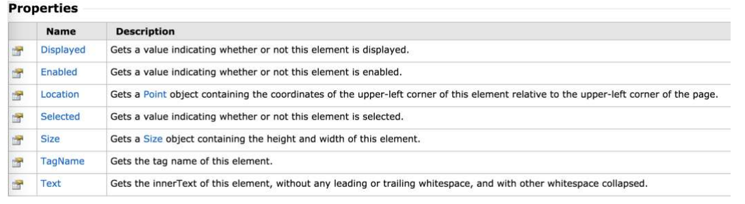
WebElement Commands
WebElement represents the HTML document of a page

Slide 12
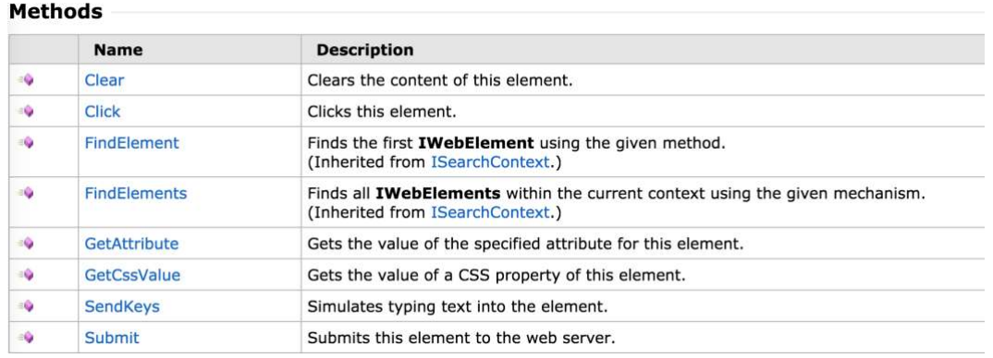

Slide 13
Locators

Slide 14
Locating Elements in a page
Locating Elements in a page is done by using the FindElement or FindElements.
You’ll need the By.Locator to use FindElement or FindElements
Locators
By.Id
IWebElement element = driver.FindElement(By.Id(”password"));
By.Name
IWebElement element = driver.FindElement(By.Name(”password"));
By.ClassName
IWebElement element = driver.FindElement(By.Name(”form-control "));
By.TagName
IWebElement element = driver.FindElement(By.TagName(”button"));
By.Xpath
IWebElement element = driver.FindElement(By.Name(@”//*[@id=""password""]"));

Slide 15
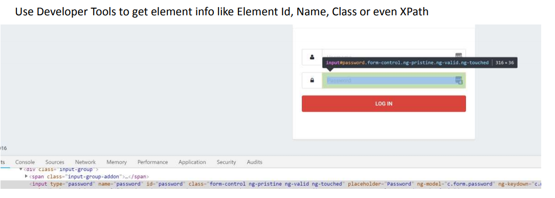
Getting element info

Slide 16
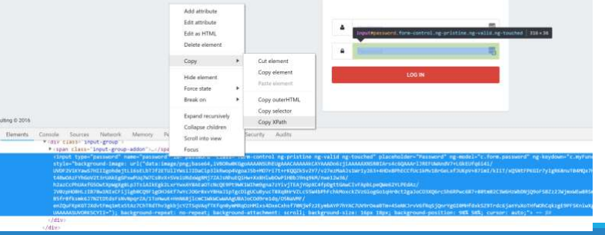
Getting element info
Use can use Developer Tools to get the Xpath of an element

Slide 17
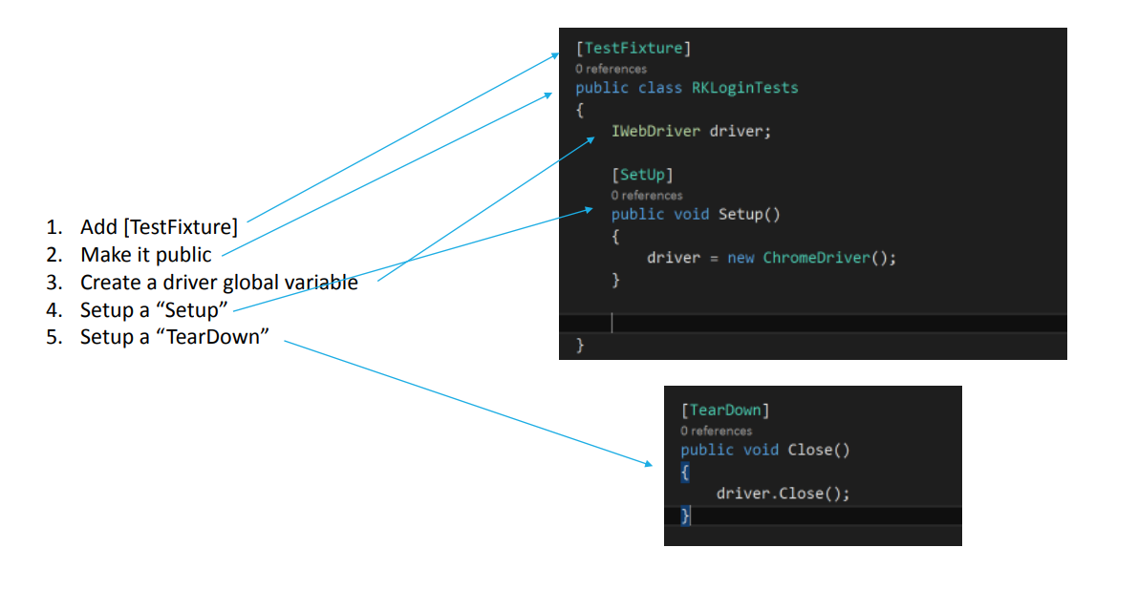
Writing & Running Tests

Slide 18
Sample Sources
http://toolsqa.com/selenium-c-sharp/
https://www.guru99.com/selenium-csharp-tutorial.html
https://seleniumhq.github.io/selenium/docs/api/dotnet
https://dzone.com/articles/top-10-automated-software-testing-tools

